Slide 1
CONSULTATION 3
Physical DFD, Network Architecture DFD, and Data Distribution Architecture Diagram
Notes:
This repository of slides is intended to support the named chapter. The slide repository should be used as follows:
Copy the file to a unique name for your course and unit.
Edit the file by deleting those slides you don’t want to cover, editing other slides as appropriate to your course, and adding slides as desired.
Print the slides to produce transparency masters or print directly to film or present the slides using a computer image projector.
Each slide includes instructor notes. To view those notes in PowerPoint, click left on the View Menu; then click left on Notes View sub-menu. You may need to scroll down to see the instructor notes.
The instructor notes are also available in hard copy as the Instructor Guide to Accompany Systems Analysis and Design Methods, 5/ed.

Slide 2
Physical Data Flow Diagrams (DFDs)
Physical data flow diagrams (DFDs) model the technical and human decisions to be implemented as part of an information system. They communicate technical choices and other design decisions to those who will actually construct and implement the system.

Slide 3
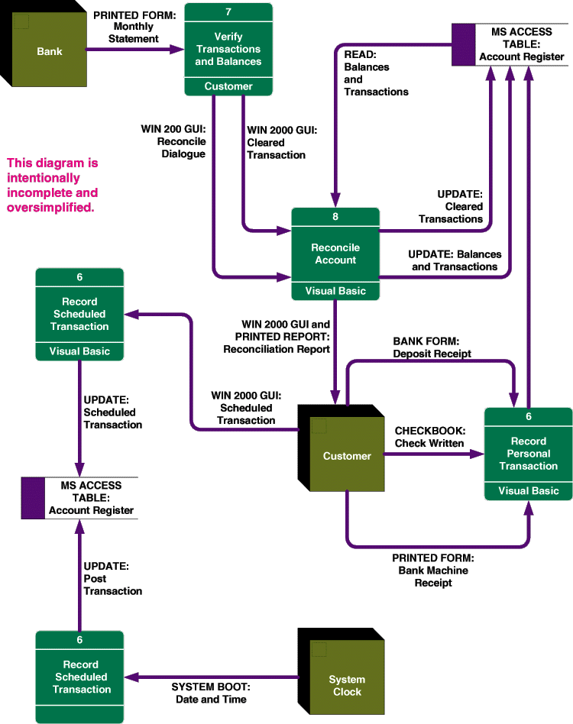
Sample Physical Data Flow Diagram

Slide 4
Physical Processes
A physical process is either a processor, such as a computer or person, or a technical implementation of specific work to be performed, such as a computer program or manual process.
  Logical processes may be assigned to physical processors such as PCs, servers, mainframes, people, or devices in a network. A physical DFD would model that network structure.
  Each logical process requires an implementation as one or more physical processes. Note that a logical process may be split into multiple physical processes:
    To define those aspects that are performed by people or computers.
    To define those aspects to be implemented by different technologies.
    To show multiple implementations of the same process.
    To add processes for exceptions and internal control (e.g., security).

Slide 5
Physical Process Notation

Slide 6
Samples of Physical Processes

Slide 7
Possible Computer Process Implementations
A purchased application software package
  Also called commercial off-the-shelf (COTS) software
A system or utility program
An existing application program
  May require modification
A program to be written

Slide 8
Sample Physical Process Implementations

Slide 9
Physical Data Flows
A physical data flow represents any of the following:
  The planned implementation of an input to, or output from a physical process.
  A database command or action such as create, read, update, or delete.
  The import of data from, or the export of data to another information system across a network.
  The flow of data between to modules or subroutines (represented as physical processes) in a program.

Slide 10
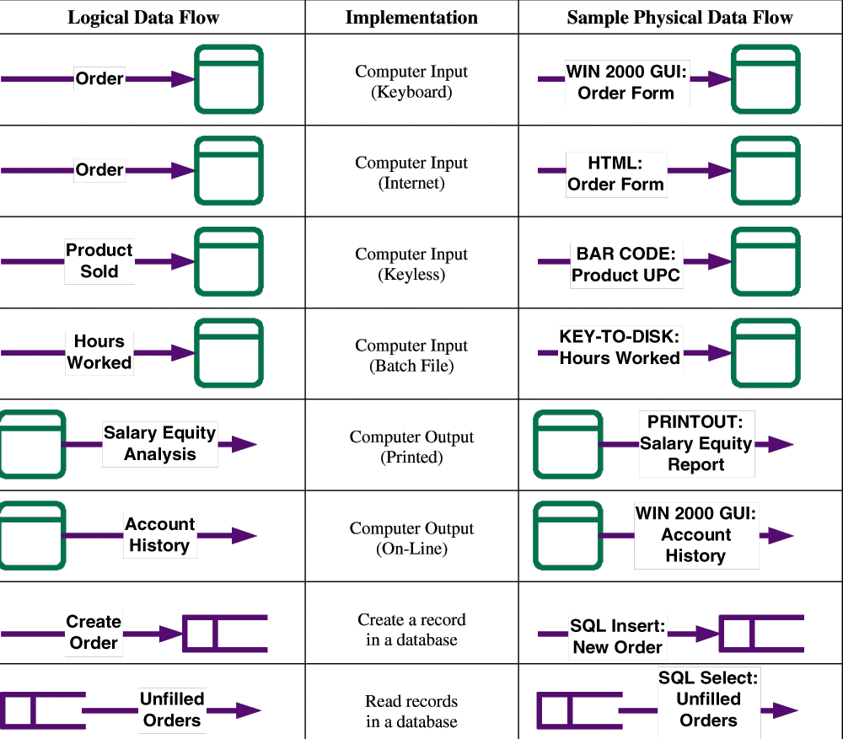
Sample Physical Data Flows

Slide 11
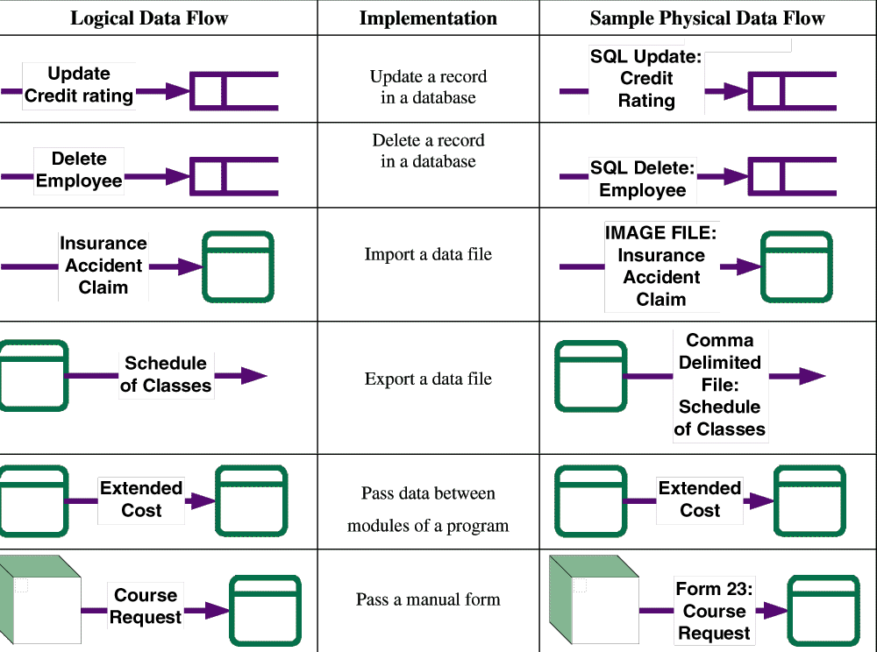
Sample Physical Data Flows (continued)

Slide 12
Physical External Agents and Data Stores
Physical external agents are carried over from the logical DFD models.
  If scope changes, the logical models should be changed before the physical models are drawn.
A physical data store represents the planned implementation of one of:
  A database
  A table in a database
  A computer file
  A tape or media backup of anything important
  A temporary file or batch
  Any type of noncomputerized file

Slide 13
Physical Data Store Notation

Slide 14
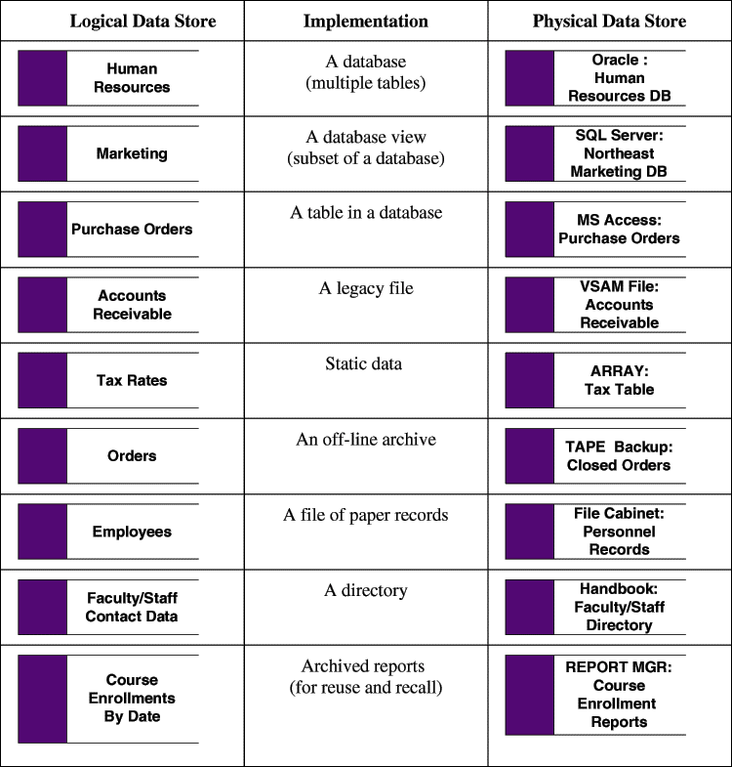
Physical Data Store Implementations

Slide 15
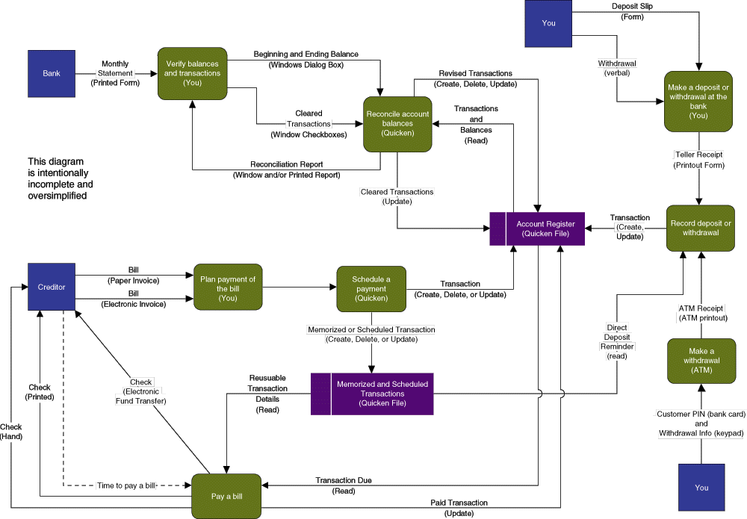
Sample Physical Data Flow Diagram

Slide 16
The Network Architecture DFD
A network architecture is documented as a physical DFD that allocates processors (clients and servers) and possibly devices (machines and robots) across a network and establishes (1) the connectivity between clients and servers, and (2) where users will interface with the processors.

Slide 17
Network Architecture DFD
A network architecture DFD, typically the first physical DFD to be drawn, is a physical data flow diagram that allocates processors (clients and servers) and devices (e.g., machines and robots) to a network and establishes (1) the connectivity between the clients and servers and (2) where users will interact with the processors (usually only the clients).
To identify the processors and their locations, the developer utilizes two resources:
If an enterprise information technology architecture exists, that architecture likely specifies the client/server vision that should be targeted.
The advice of competent network managers and/or specialists should be solicited to determine what's in place, what's possible, and what impact the system may have on the computer network.

Slide 18
Network Architecture DFD
Network architecture DFDs need to be labeled to show somewhat different information than normal DFDs. They don't show specific data flows per se. Instead, they show highways over which data flows may travel in either direction. Also, network topology DFDs indicate the following:
Servers and their physical locations. Servers are not always located at the sites indicated on a location connectivity diagram. Network staff access to servers is usually an issue. Some network management tasks can be accomplished remotely, and some tasks also require hands-on access.
Clients and their physical locations. In this case, the location connectivity diagram is useful in identifying “classes” of like users (e.g., ORDER CLERKS, SALES REPRESENTATIVES, etc.) who will be serviced by similar clients. A single processor should represent the entire class at a single location. The same class may be replicated in multiple locations. For example, you would expect each sales region to have similar types of employees.

Slide 19
Network Architecture DFD
Processor specifications. The repository descriptions of processors can be used to define processor specifications such as RAM, hard disk capacity, and display.
Transport protocols. Connections are labeled with transport protocols (e.g., TCP/IP) and other relevant physical parameters.
The network topology DFD can be used to either design a computer network, or to document the design of an existing computer network. In either case, the network is being modeled so that we can subsequently assign information system processes, data stores, and data flows to servers on the network.

Slide 20
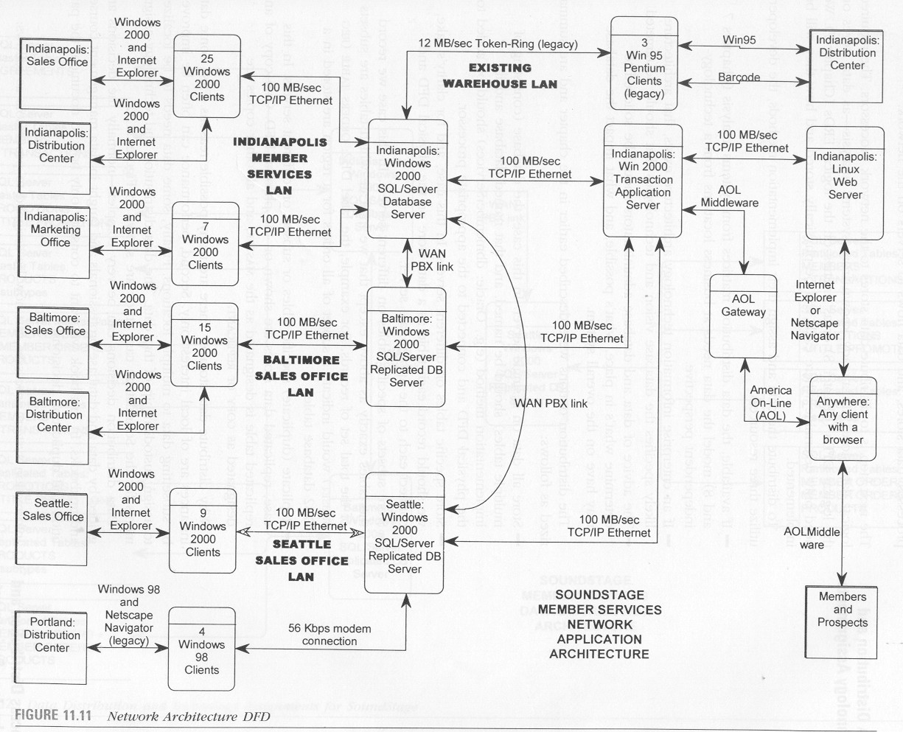
Sample Network Architecture DFD

Slide 21
Data Distribution Architecture/Technology Assignment Diagram
The next step is to distribute data stores to the network processors. The required logical data stores are already known from systems analysis - as data stores on the logical DFDs or as entities on the logical ERDs. We need only determine where each will be physically stored and how they will be implemented.
To distribute the data and assign their implementation methods, the developers utilize three resources:
If available, data distribution matrices from systems analysis model the data needs at business locations from a technology-independent perspective.
If an enterprise information technology architecture exists, that architecture likely specifies the database vision and technologies that should be targeted.
The advice of data and database administrators should be solicited to determine what's in place, what's possible, and what impact the database may have on the overall system.

Slide 22
Data Distribution Architecture/Technology Assignment Diagram
The distribution options were described earlier in the chapter and are summarized as follows:
Store all data on a single server. In this case, the database (consisting of multiple tables) should be named, and that named database and its implementation method (e.g., Oracle: dbmemberservices) should be added to the physical DFD and connected to the appropriate processor.
Store specific tables on different servers. in this case, and for clarity's sake, we should record each table as a data store on the physical DFD and connect each to the appropriate server.
Store subsets of specific tables on different servers. In this case we record the tables exactly as above except that we indicate which tables are subsets of the total set of records. For example, the label DB2: “ORDERS TABLE (REG SUBSET)” would indicate a subset of all orders for a region are stored in a DB2 database table.

Slide 23
Data Distribution Architecture/Technology Assignment Diagram
Replicate (duplicate) specific tables or subsets on different servers. In this case, replicated data stores are shown on the physical DFD. One copy of any replicated table is designated as the “MASTER,” and all other copies are designated as “COPY” or “REPLICANT.”
Why distribute data storage? There are many possible reasons. First, some data instances are of local interest only. Second, performance can often be improved by subsetting data to multiple locations. Finally, some data needs to be localized to assign custodianship of that data. Data distribution decisions can be very complex-normally the decisions are guided by data and database professionals and taught in data management courses and textbooks. We want to consider only how to document the partition and duplication decisions.

Slide 24
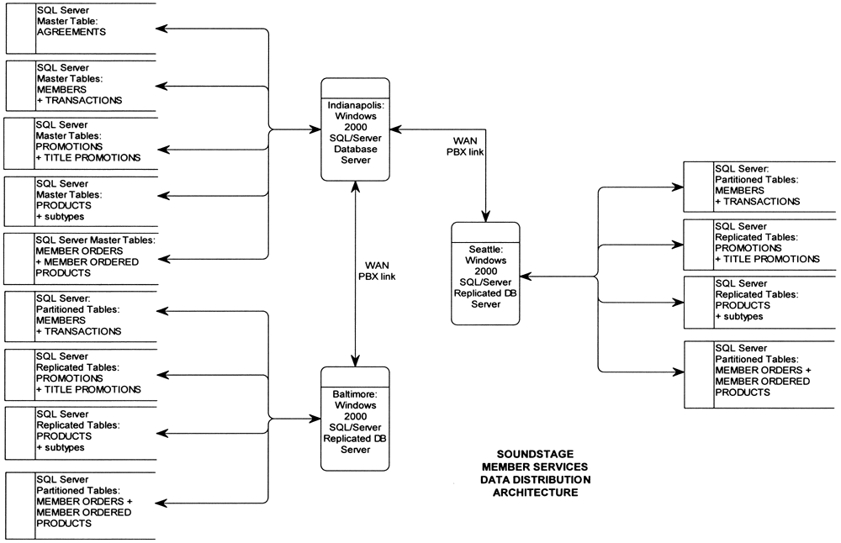
Data Distribution Architecture/Technology Assignment Diagram

