Slide 1
Defoliators and Wood Products Pests
Laboratory #3

Slide 2
Objectives:
To familiarize you with the variation in insects.
To know and identify important defoliators and wood products pests in our forests.

Slide 3
Insect Defoliators

Slide 4
Defoliation Facts
Defoliation-thinning or absence of foliage; visible frass
Defoliator Types:
Chewers-devour leaves and needles completely
Skeletonizers-feed on soft parts of leaves; leave a skeletal network
Miners-bore inside leaves and feed between epidermis
Some insects eat only new foliage (Ex: Western spruce budworm)
Others consume new and old foliage (Ex: Douglas-fir tussock moth)
Polyphagous-feed on many hosts
Oligophagous-feed on only a few hosts
Monophagous-feeds on one host

Slide 5
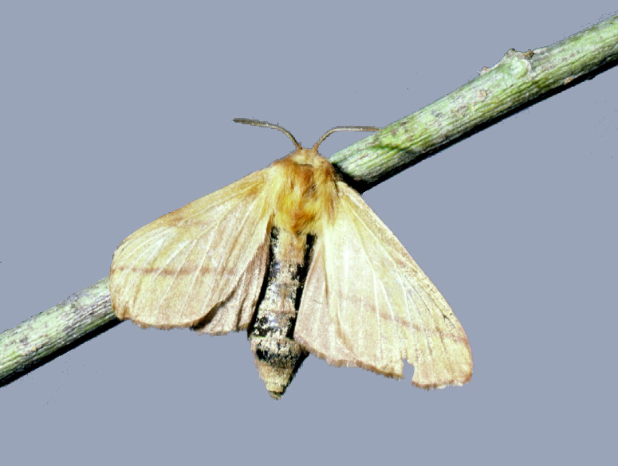
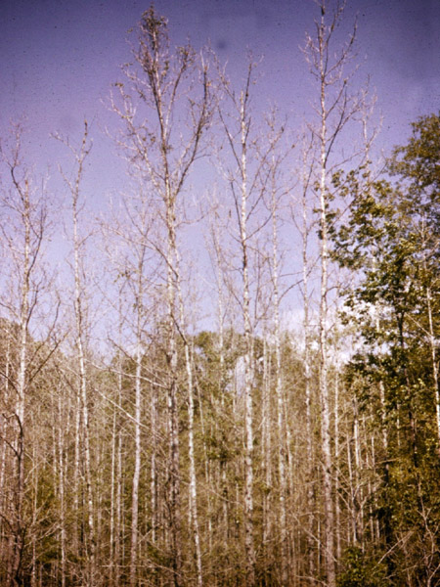
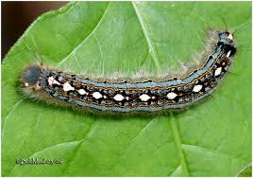
Forest Tent Caterpillar
Does not form a tent
Adults: light brown colored wings with darker stripes
Larva: has a key-hole shaped spot on its back

Slide 6
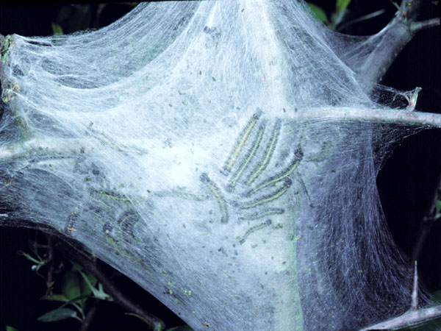
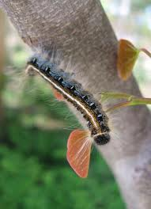
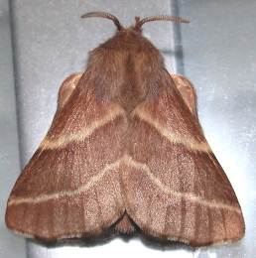
Eastern Tent Caterpillar
Forms a tent in tree crotches
Stays in tent during the day and feeds at night
Adults: dark brown wings with light stripes

Slide 7
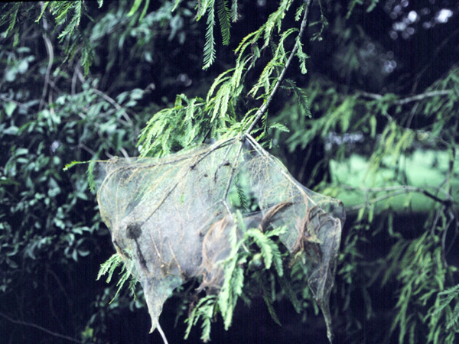
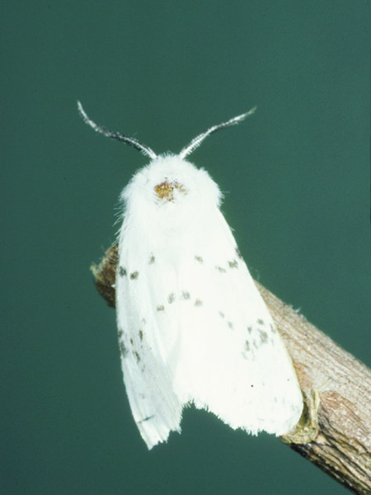
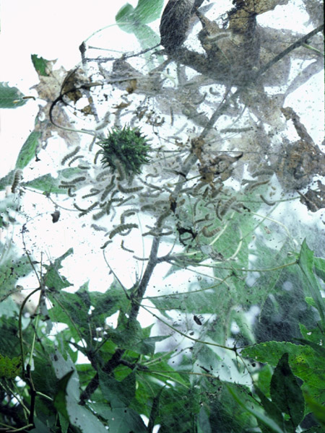
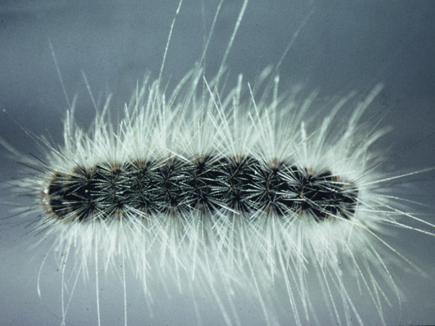
Fall Webworm
Builds web on the end of limbs
Feed on hardwoods, especially pecan, persimmon, walnut, and elm

Slide 8
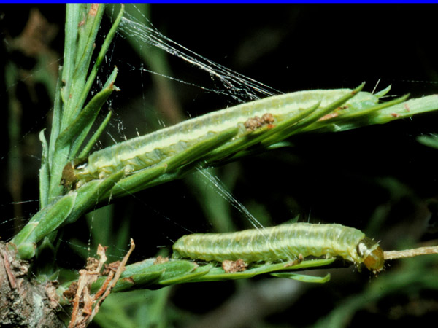
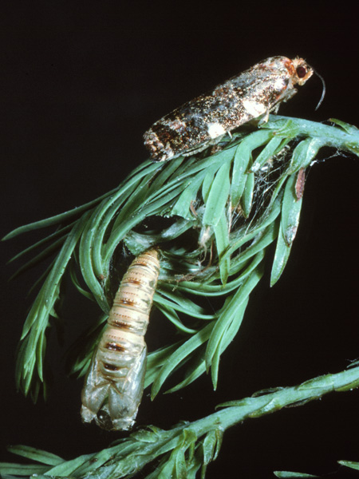
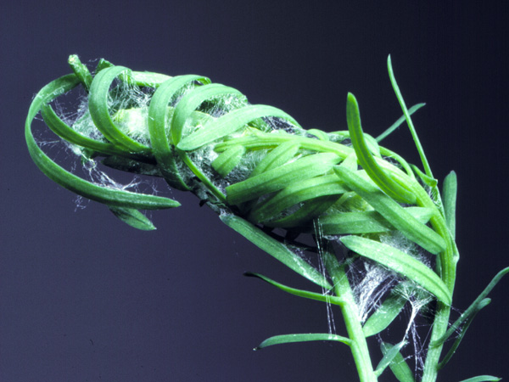
Cypress Leafroller
Popular in cypress areas, esp. Louisiana
Roll leaves (needles) over themselves in late instars to pupate

Slide 9
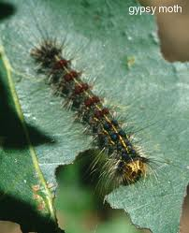
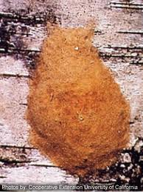
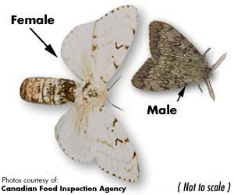
Gypsy Moth
Feed on hardwoods and conifers
They lay egg masses on tree trunks or in crevasses
Larvae: 5 pairs of blue spots and 6 pairs of red spots; hairy
Adults: Female is larger and white; male is smaller and brownish-tan

Slide 10
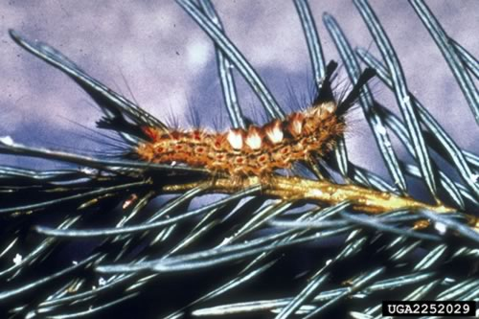
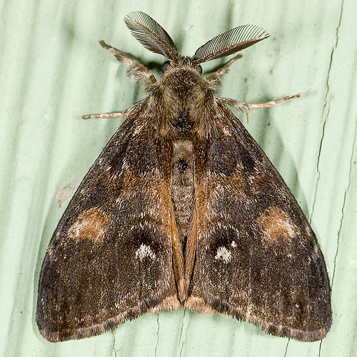
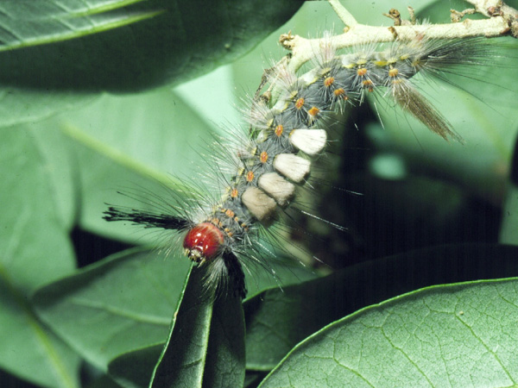
Tussock Moths
Larvae recognized by their tussocks or tufts of hair
“Toothbrush-like” bristles on their back
Adults are either dull brown or white

Slide 11
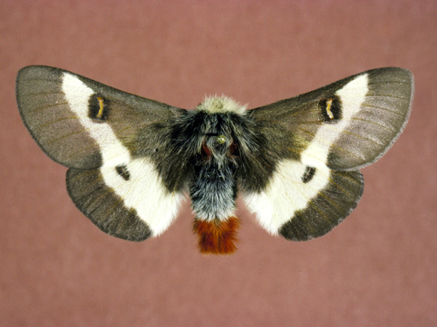
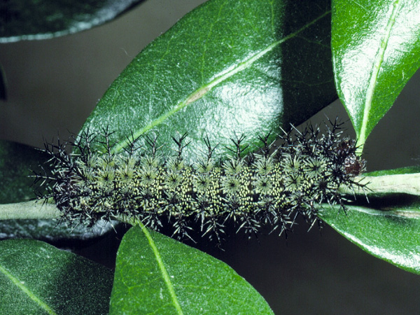
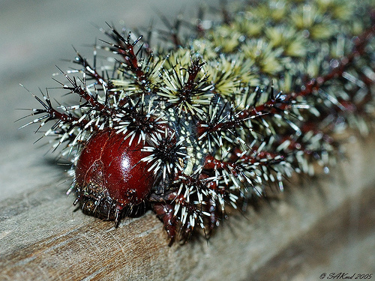
Buck Moth
Large larvae with toxic branching spines to fend away predators
Feed primarily on oaks

Slide 12
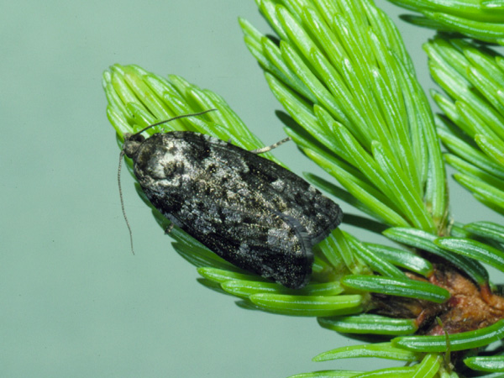
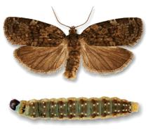
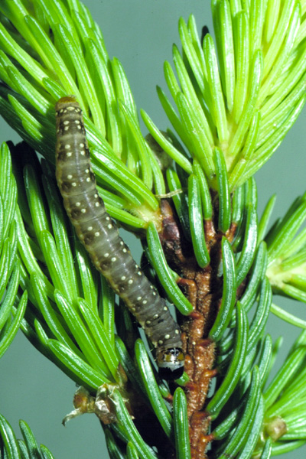
Spruce Budworm
Larvae: dark brown heads and bodies with light colored spots down the back
Adults: about ½ inch long; wing coloration is orange-brown to gray

Slide 13
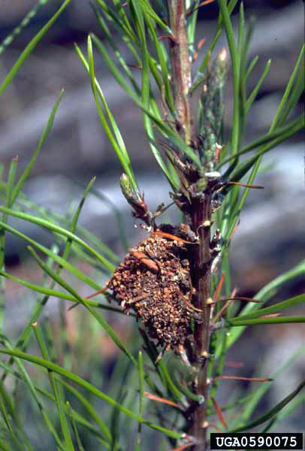
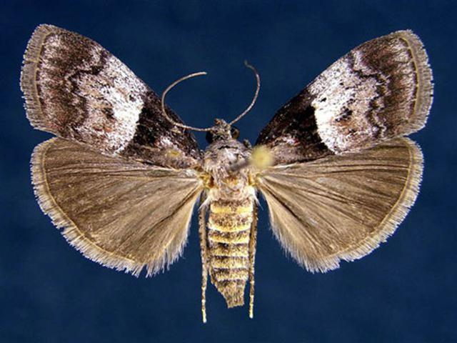
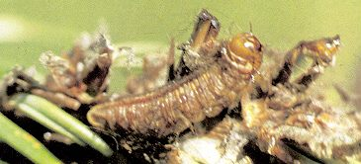
Pine Webworm
Larvae: light gray with dark tan stripes along the length of their body (3/4 inch)
Adults: gray with grayish-black forewings; 1 inch wingspan

Slide 14
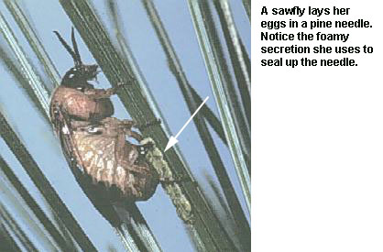
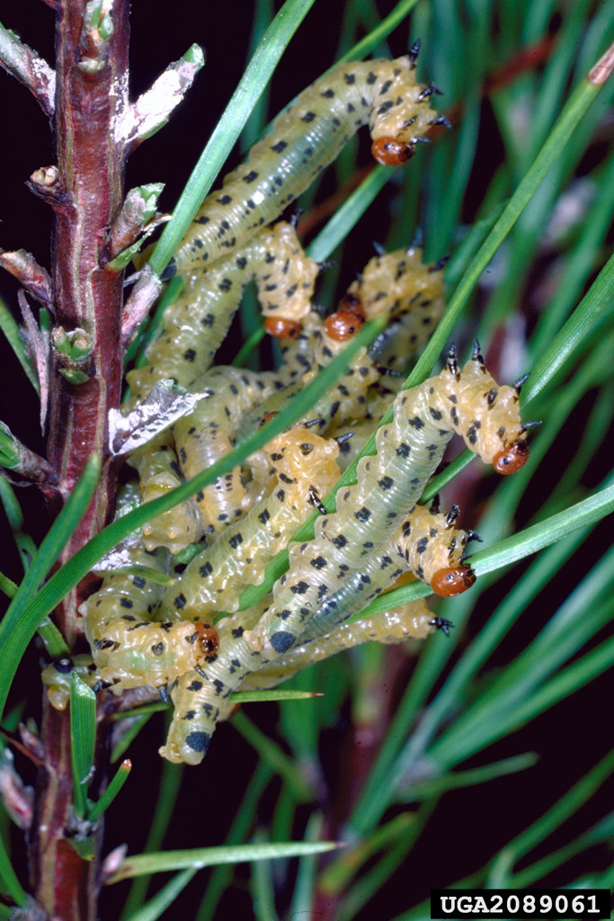
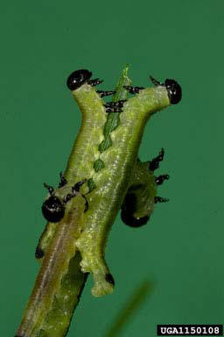
Sawflies

Slide 15
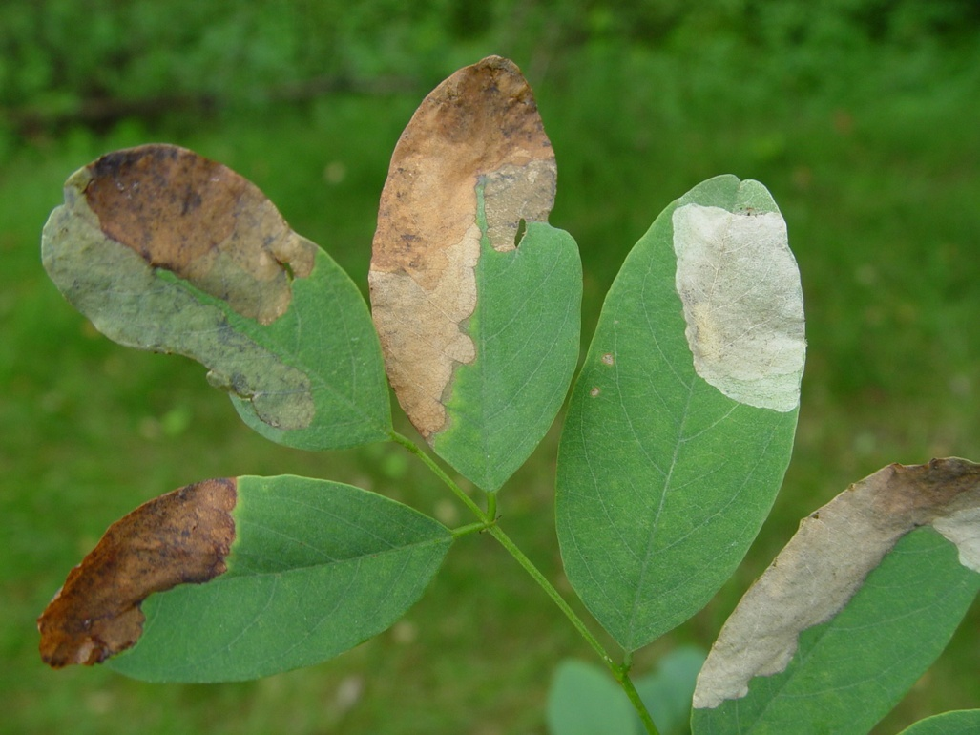
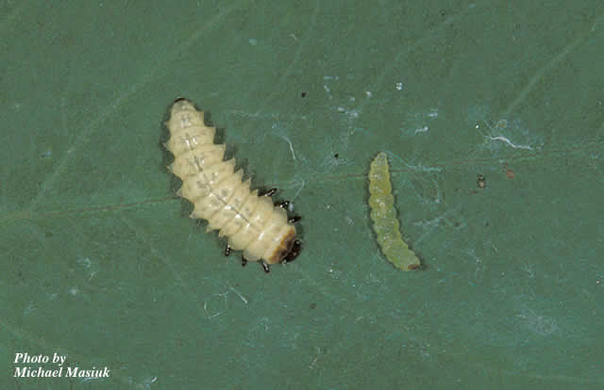
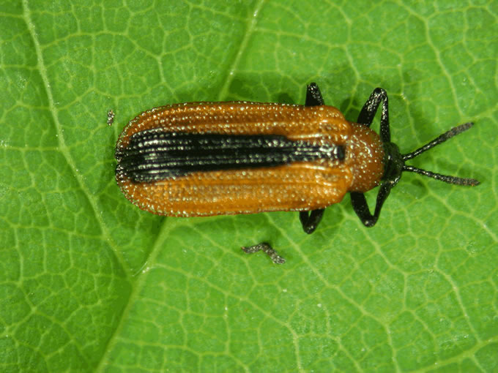
Locust Leafminer
•Primarily a pest of black locust.
•Adult: head is black and the wing covers are orange with a broad black or brow stripe.

Slide 16
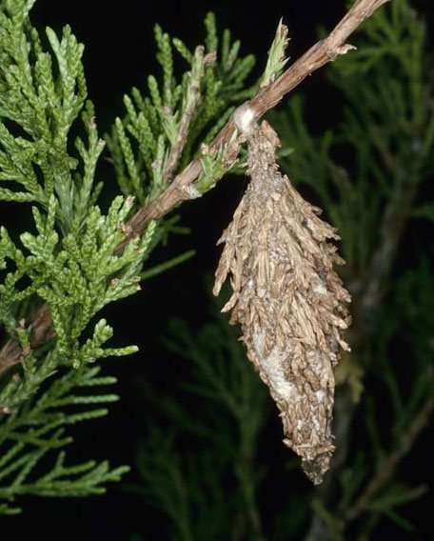
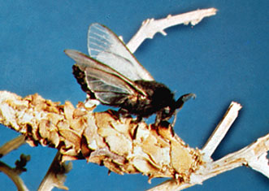
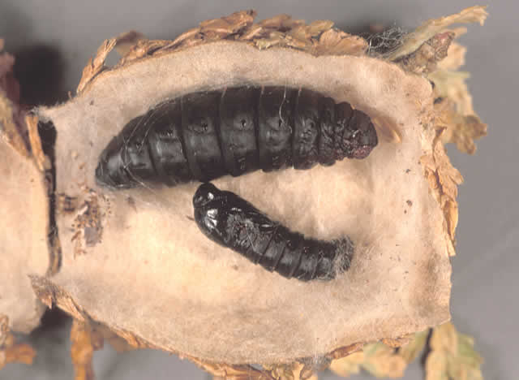
Bagworm
Build cone-shaped bags out of silk, leaves, and twigs
Larvae are shiny black with a dull amber underside
Adult males are moths that can fly
Females remain in the bags as grubs and never become moths

Slide 17
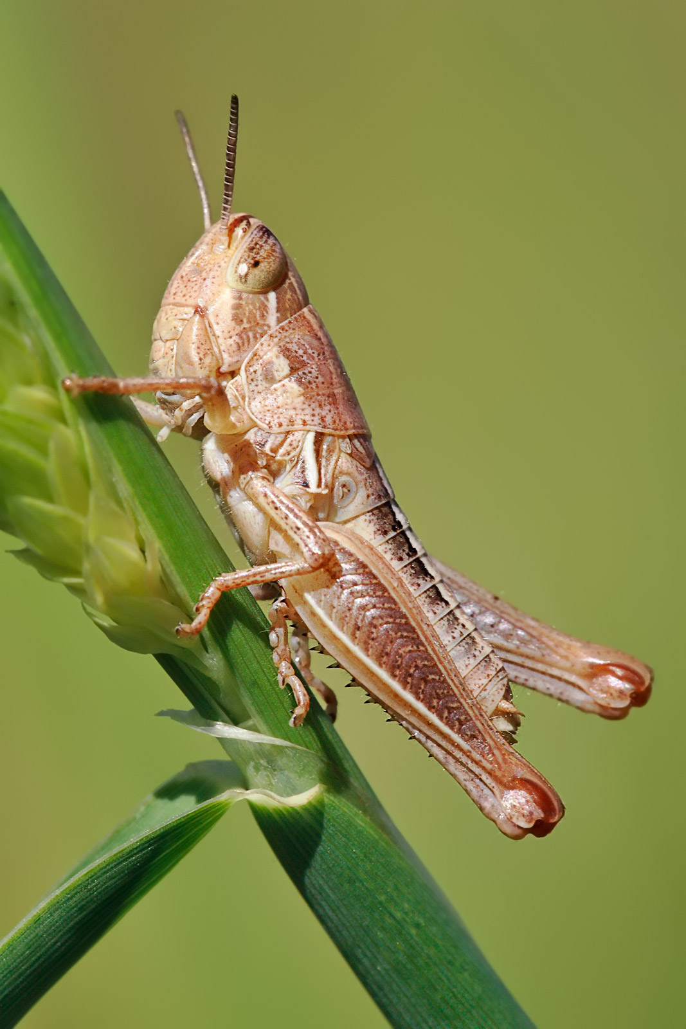
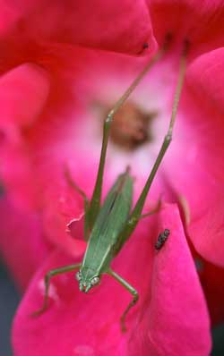
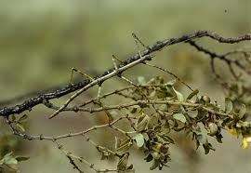
Other Defoliators
Grasshoppers: prefer to eat grasses, leaves and cereal crops; big hind legs for jumping; antennae includes 20-24 segments; cerci unjointed.
Katydids: eat the leaves of willow, rosewood and citrus trees; they are green or, occasionally, pink; males have song-producing organs located on their front wings;
Walking Sticks: young nymphs feed on low-growing plants, such as beaked hazel, rose, sweetfern and blueberry. black oak, basswood, and wild cherry are preferred by older nymphs and adults.

Slide 18
Wood Products Pests

Slide 19
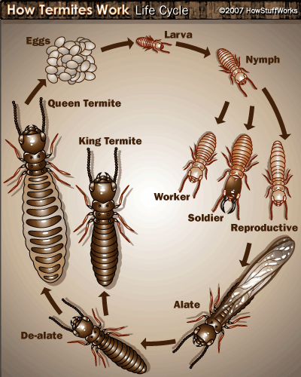
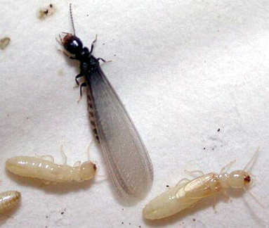
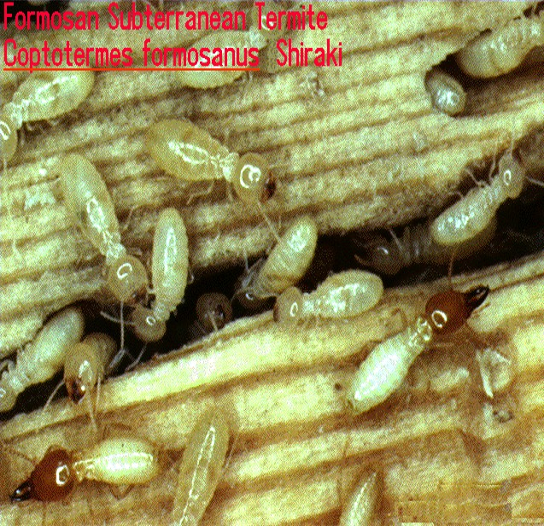
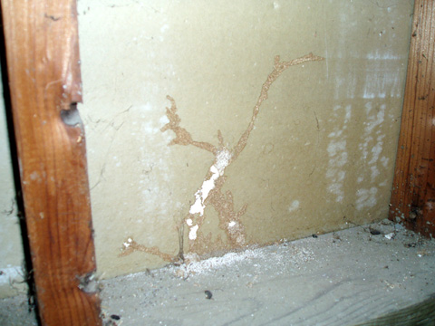
Subterranean Termites
Swarmer with workers
Soldiers

Slide 20
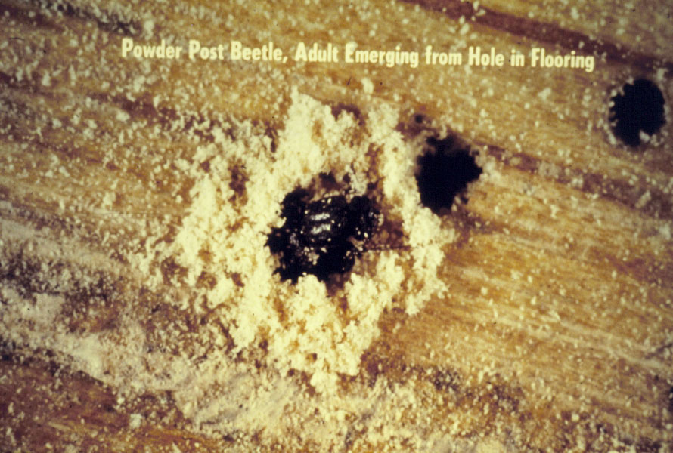
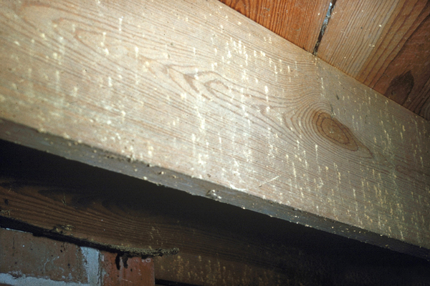
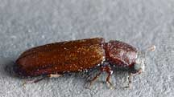
Large & Lyctid Powderpost Beetles
Larvae: C-shaped
Adults: Small (< ¼ inch long); flattened appearance; reddish-brown to black

Slide 21
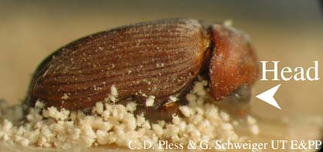
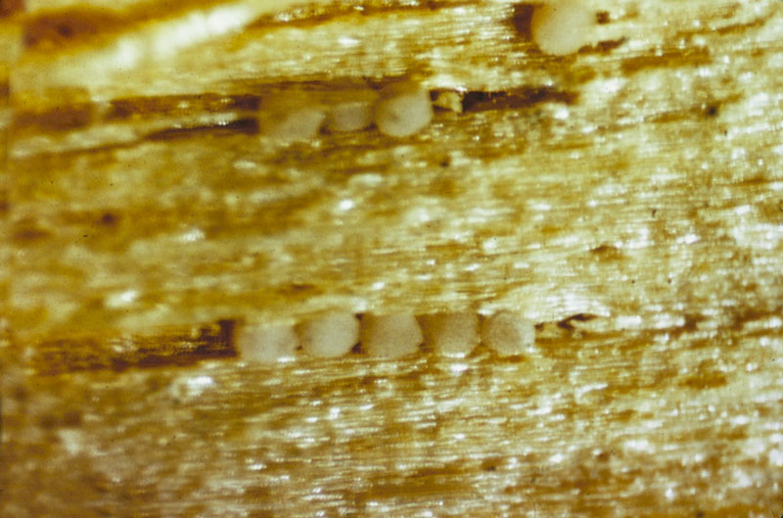
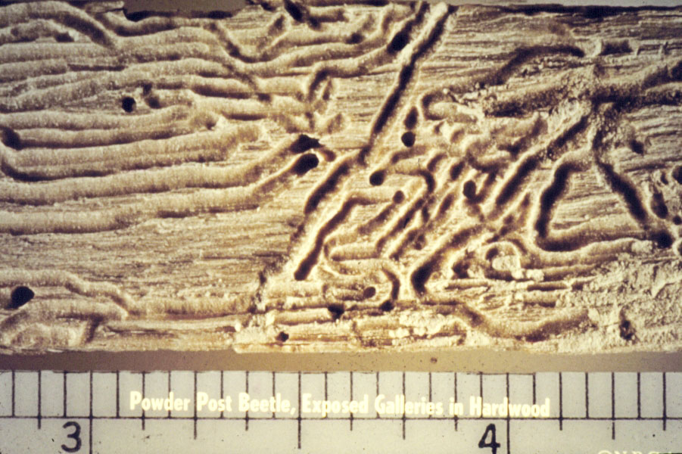
Anobiid Powderpost Beetle

Slide 22
Carpenter Bees
Females tunnel and lay eggs
Leave a pollen ball in tunnel for larvae to feed
Differ from bumble bees by having a black upper abdomen devoid of hair

Slide 23
Carpenter Ants
Excavate wood galleries to lay eggs and raise young
Like most ant species, they eat honeydew formed from aphids
Also prey on termites

Slide 24
Horntails
Larvae: feed in dead logs like wood-boring beetle larvae
Adults: Wider waist than found in most Hymenopterans; thorax and abdomen broadly attached

Slide 25
Exercise:
Draw insects labeling key identification structures, colors, etc.
Note damage structures.

