Slide 1
Patch Occupancy and Patch Dynamics
Single species, Single Season Occupancy

Slide 2
The Problem
Primarily interested in the proportion of sites that are occupied or the probability a particular site is occupied.
  But detection is imperfect
  Probability is an a priori expectation – e.g. probability of heads on a coin toss
  Proportion is the realization of the expectation – proportion of heads in 10 coin tosses
Why?
  Occupancy → Abundance → Vital rates

Slide 3
Patch Occupancy:
Probability use of sampling unit by one or more species of interest
  pond-dwelling amphibians – pond is unit of interest
  terrestrial bird – forest patch, or arbitrary block of land
  fish – stream or stream reach

Slide 4
Approaches
Sample multiple sites several times in quick succession (temporal replication)
  Assume that use does not change during the time between surveys
Sample multiple locations within each site (spatial replication)
  Assume that use does not change during the time between surveys
  Assume that probability of use at each location is identical

Slide 5
Basic sampling protocol
Visit sites and spend time looking for individuals of interest or evidence that they are present
Repeated presence-absence surveys
  Temporal replication at same site
  Spatial replication
Relies on multinomial MLE to estimate probability of use (ψ) and detection (p)
  Similar to probability of encounter from the multinomial example

Slide 6
Examples
Probability of use of ponds by an amphibian species
  Sampling unit – pond (temporal replication)
Proportion of use of an area by a bird species
  Sampling unit – regular grid (temporal replication)
Probability of territory occupancy by a bird or mammal
  Sampling unit – territory (temporal replication)
Probability of shoal use by crayfish
  Sampling unit - shoal (spatial replication)

Slide 7
Still important
Study design
  Scope of inference
  Elements of stratification and randomization
Strength of inference.
  Strongest – experimental manipulation
  Weaker – constrained designs (e.g., before & after)
  Weaker still – a prior modeling
  Worst – a posteriori storytelling

Slide 8
Analysis
Historically, estimates of occupancy based on the portion of sites where presence was detected.
Problem – detection is not often perfect e.g., animals present or site was used but no sign was seen.
“False absences” bias estimates of use downward
Bias increases with rare and elusive animals – often species of greatest concern
Like capture-mark-recapture methods occupancy analysis explicitly deals with the nuisance parameter of detection rate.

Slide 9
Important Sources of Variation
Spatial variation
  Interest in large areas that cannot be completely surveyed
  Sample space in a manner permitting inference about entire area of interest
Estimating detection probability essential
  Even on surveyed sites
  Samples don’t usually detect
  all animals present

Slide 10
Applications

Slide 11
Determining range extent
Usually involve the use of presence-absence data,
Frequently by "connecting the dots,"
  Extent of occurrence like typical range maps
  Can allow for breaks in distribution
Failures to detect ⇨under-estimate range

Slide 12
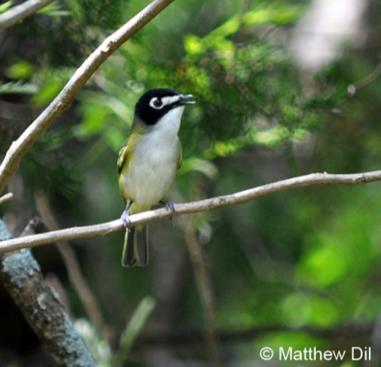
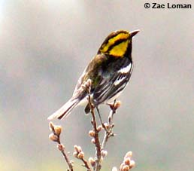
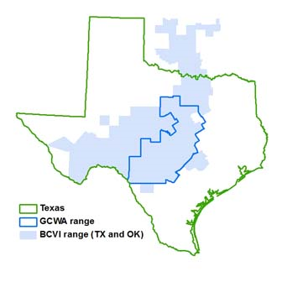
Determining range extent
Occupancy analysis
  Accounts for failures to detect – “false absences”
  Allows examining the probabilistic distribution and relationships to biotic and abiotic factors

Slide 13
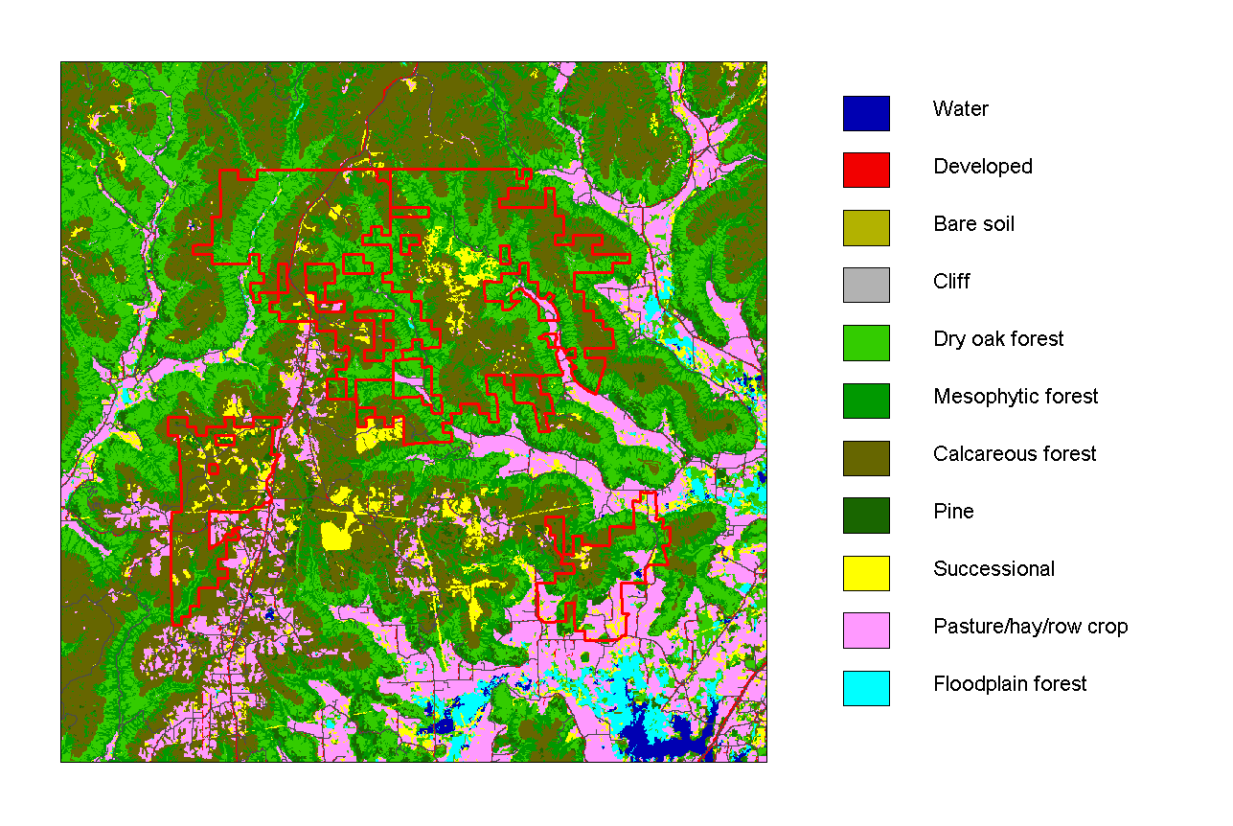
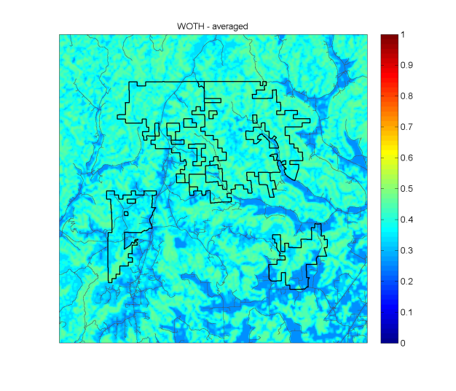
Habitat relationships and resource selection
Studies of habitat use seek to identify key habitat attributes to which species respond
Frequently employ presence-absence surveys
Often use logistic regression –
  fails to account for "false absences,"
  i.e. imperfect detection
Failure to account for detectability biases estimated relationships and variance (too small)

Slide 14
Metapopulations (Levins 1969, 1970)
Defined:
Population composed of localized subpopulations that are connected through animal movements and have some probability of extinction and re-colonization
Equivalent to a system of “patches” that are sometimes occupied

Slide 15
Metapopulations – single-season approaches
Based on snapshot of occupancy – aka static occupancy
Relation to metapopulation
  based on incidence functions
  factors that influenced the probability of occurrence (Diamond 1975)
Uses the probability of occupancy to directly estimate metapopulation dynamics (Hanski 1991, 1992)
Probability of occupancy can vary among patch in relation to factors such as size, proximity, configuration, composition, fragmentation, etc.

Slide 16
Large-scale monitoring programs
Occupancy (presence-absence) surveys are less costly than estimating abundance or density
Nearly as useful as estimates of abundance or trend
Sometimes incorrectly used as a surrogate for abundance

Slide 17
Methods that do not estimate detection rates
lead to biased estimates of occupancy
and
associated problems
with the interpretation of estimated parameters.

Slide 18
Basic Sampling Scheme
N sites are surveyed, each at T distinct sampling occasions
Species is detected/not detected at each occasion at each site

Slide 19
Encounter history data
1 = detection, 0 = non-detection
Examples:
  Detections on occasions 1, 2, 4: 1101
  Detections on occasions 2, 3: 0110
  No detections at site: 0000
1 detection history for each site sampled

Slide 20
Distinct sampling occasions may be:
Repeated visits on different days
Multiple surveys on the same visit
Small time periods within a survey
  e.g., detection/non-detection is recorded every minute of a 5-minute auditory survey
Multiple “locations” within a site
  Spatial replication
However, want to maintain detection probability at a reasonable level (e.g., >0.10)

Slide 21
Model Parameters
ψ_{i} -probability site i is occupied
p_{ij} -probability of detecting the species in site i at time j, given species is present

Slide 22
Model assumptions
The system is demographically closed to changes in the occupancy status of site during the sampling period.
  At the species level
    No colonization of (immigration to) a site
    No local extinction (emigration from) a site
Species are not falsely detected.
Detection at a site is independent of detection at other sites.
  Far enough apart to be biologically independent.

Slide 23
Model Assumptions
  Sites are closed to changes in occupancy state between sampling occasions
  Species are not falsely detected.
  The detection process is independent at each site
    Far enough apart to be biologically independent.
  No heterogeneity in occupancy
    than cannot be explained by covariates
  No heterogeneity in detection
    that cannot be explained by covariates

Slide 24
A Probabilistic Model
Pr(detection history 1001) =
Pr(detection history 0000) =

Slide 25
A Probabilistic Model
The combination of these statements forms the model likelihood
Maximum likelihood estimates of parameters can be obtained
However, parameters cannot be site specific without additional information (covariates)
Suggest parametric bootstrap be used to estimate GOF
  As in MARK but see MacKenzie and Bailey (2005)

Slide 26
Summary Statistics
n_{j} - number of sites at which species was detected at time j
n. - total number of sites at which species was detected at least once
N - total number of sites surveyed
Naïve estimate of occupancy:

Slide 27
The Likelihood Function
N – total number of surveyed sites
p_{j} – probability of detection at time j
n. - total number of sites at which species was detected at least once
n_{j} - number of sites at which species was detected at time j

Slide 28
Does It Work?
Simulation study to assess how well ψ is estimated
(MacKenzie et al. 2002)
  T = 2, 5, 10
  N = 20, 40, 60
  ψ = 0.5, 0.7, 0.9
  p = 0.1, 0.3, 0.5
  m = 0, 0.1, 0.2

Slide 29
Does It Work?
Generally unbiased estimates when Pr(detecting species at least once) is moderate (p> 0.1) and T> 5
Bootstrap estimates of SE also appear reasonable for a similar range

Slide 30
Including Covariates
ψ may only be a function of site-specific covariates
  covariates of ψ that do not change during the survey
    i.e., habitat type or patch size
p may be a function of site and/or time specific covariates
  covariates that may vary with each sampling occasion and possibly site
    i.e., cloud cover or air temperature

Slide 31
Including Covariates
e.g., Linear-logistic function: covariates for site (X_{i}) and sampling occasion (T_{ij})

Slide 32
Including Covariates
Average Pr(occupancy):

Slide 33
Example: Anurans at Maryland Wetlands
(Droege and Lachman)
Frogwatch USA (NWF/USGS) – now PARC
Volunteers surveyed sites for 3-minute periods after sundown on up to 10 nights
29 wetland sites; piedmont and coastal plain
27 Feb. – 30 May, 2000
Covariates:
  Sites: habitat
  ([pond, lake] or [swamp, marsh, wet meadow])
  Sampling occasion: air temperature

Slide 34
Example: Anurans at Maryland Wetlands
(Droege and Lachman)
Spring peeper (Hyla crucifer)
  Detections at 24 of 29 sites (0.83)
American toad (Bufo americanus)
  Detections at 10 of 29 sites (0.34)

Slide 35
Example: Anurans at Maryland Wetlands
(H. crucifer)
Model | ΔAIC | w_{i}
ψ(hab)p(tmp) | 0.00 | 0.85 | 0.84 | 0.07
ψ(.)p(tmp) | 1.72 | 0.15 | 0.85 | 0.07
ψ(hab)p(.) | 40.49 | 0.00 | 0.84 | 0.07
ψ(.)p(.) | 42.18 | 0.00 | 0.85 | 0.07

Slide 36
Example: Anurans at Maryland Wetlands
(B. americanus)
Model | ΔAIC | w_{i}
ψ(hab)p(tmp) | 0.00 | 0.36 | 0.50 | 0.13
ψ(.)p(tmp) | 0.42 | 0.24 | 0.49 | 0.14
ψ(hab)p(.) | 0.49 | 0.22 | 0.49 | 0.12
ψ(.)p(.) | 0.70 | 0.18 | 0.49 | 0.13

Slide 37
Software
Windows-based software
  Program PRESENCE – pwrc.usgs.gov
    Specialized for occupancy models only
    Version 2 estimates abundance from counts
    Version 3 adds spatial autocorrelation
  Program MARK
    Occupancy and RD Occupancy and Abundance
Fit both predefined and custom models, with or without covariates
Provide maximum likelihood estimates of parameters and associated standard errors
Assess model fit

Slide 38
Information Theoretic Methods

Slide 39
Resources
Information Theoretic Methods
  Johnson, D. H. 1999. The insignificance of statistical significance testing. Journal of Wildlife Management 63:763-772.
  Anderson, D. R., K. P. Burnham, and W. L. Thompson. 2000. Null hypothesis testing: problems, prevalence, and an alternative. Journal Wildlife Management 64:912-923.
  Anderson, D. R., K. P. Burnham. 2002. Avoiding pitfalls when using information-theoretic methods. Journal Wildlife Management 66:912-918.
Information Theoretic Methods: model selection
  Burnham, K. P., and D. R. Anderson. 2002. Model selection and multi-model inference: a practical information theoretic approach. 2nd ed. Springer-Verlag, New York, NY.

Slide 40
Models
“All models are wrong; some are useful.”
George Box
Approximations of reality.
A statistical model is a mathematical expression that help us predict a response (dependent) variable as a function of explanatory (independent) variables based on a set of assumptions that allow the model not to fit exactly.

Slide 41
Parsimony
Defined - Economy in the use of means to an end.
…[using] the smallest number of parameters possible for adequate representation of the data.”
Box and Jenkins (1970:17)
In the context of our analyses, we strive to be economical in the use of parameters to explain the variation in data.

Slide 42
Precision versus bias
Unbiased; Precise
Biased; Precise
Biased; Imprecise
Unbiased; Imprecise

Slide 43
Trade-off between precision and bias.
  As K, the number of parameters increases, bias² decreases and precision increases.
Best
Approximating
Model

Slide 44
Information Criterion
Kullback-Leibler (Kullback and Liebler 1951) “distance," or “information" seeks to describe the difference between models and forms theoretical basis for data-based model selection.

Slide 45
AIC—Akaike's Information Criterion
Akaike's Information Criterion or AIC (Akaike 1973)
  expected Kullback-Leibler information
  Fisher's maximized log-likelihood function
  maximum log-likelihood is biased upward.
    bias ≈ K (the number of estimable parameters)
AIC = -2ln(L)+2K

Slide 46
AIC—Akaike's Information Criterion
Model w/smallest value of AIC is best approximating model
If none of the models are good, AIC still selects best approximating model among those in the candidate set.
It is extremely important to assure that the set of candidate models is well-substantiated
  Plausible biological hypothesis
  Rooted in theory
AIC is only valid when comparing models fit to the same data.
Hypothesis = {T} + H

Slide 47
Adjustments to AIC – AICc
small sample size adjustment:
  K – number of parameters
  n – sample size

Slide 48
AICc
As sample size increases the penalty for each additional parameter decreases
Allows for more model
complexity with
more data

Slide 49
Overdispersion
Sampling variance exceeds the theoretical
(model-based) variance
  Lack of independence among individuals
    animals that mate for life; pair behaves as unit
    young of some species - continue to live with the parents
    species traveling in flocks or schools
  Heterogeneity – individuals having unique characteristics
    (e.g., survival or capture probability)
Can be detected by examining model "fit."

Slide 50
Goodness of fit
Similar to examining expected frequencies of genotypes and phenotypes in general biology and genetics labs.
If poor fit is detected
  Apply a variance inflation factor (c) or an estimate
  Perfect fit: c = 1.

Slide 51
Goodness of fit – c-hat
Deviance = -2ln(L _{j})+2ln (L_{sat})
Goodness of fit – χ² or G-test
Bootstrapping
Median test

Slide 52
Quasi-likelihood (QAIC)
An adjustment to AIC that incorporates c-hat is the Quasi-likelihood (Lebreton et al. 1992) and is calculated as:
and for small samples:
Influences model selection & AIC weight

Slide 53
QAIC & c-hat
As c-hat increases uncertainty increases
Increasingly
favors
simpler
models as
c-hat gets
larger
K = 7
K = 5
K = 2

Slide 54
AIC differences
AIC values are relative
Use ΔAIC – difference between AIC_{i} and min(AIC_{i})
larger ΔAIC_{i}
  reflects a greater distance between models
  lower likelihood that a model is the "best model."
Burnham and Anderson (1998) recommend
  ΔAIC_{i} < 2 – equivocal best models
  2< ΔAIC_{i} < 4 – considerable support in the data
  4 < ΔAIC_{i} < 7 – less well-supported
  ΔAIC_{i} > 10 – no support; should not be considered

Slide 55
AIC differences (example)

Slide 56
Strength of Evidence for Alternative Models
The likelihood of model i, given the data and the R models is
Normalized (so they sum to 1); interpreted as probabilities (model weights):

Slide 57
Relative “strength of evidence”
Ratio of the AIC weights.

Slide 58
Strength of Evidence (example)

Slide 59
Parameter likelihoods
Sum of the weights for models including the parameter:
where:
    w_{i} are the model weights
    I_{i} = 1 if the parameter appears in the model.
    R is the suite of models under consideration
Only applicable when parameters are equally represented in the model set

Slide 60
Incorporating uncertainty
Multi-model inference
w_{i} reflect the relative strength of evidence for model(s)
Implies uncertainty in the model selection process.
  several models may have ΔAICi < 2.0
Does not imply that the “true” model is in the model set
Need incorporate this uncertainty when estimating parameter(s) and precision.

Slide 61
Unconditional parameter estimates
Parameters (weighted average):
where:
    θ_{i} is the parameter estimate
    w_{i} are the model weights
    I_{i} = 1 if the parameter appears in the model.
    R is the suite of models under consideration

Slide 62
Parameter estimates

Slide 64
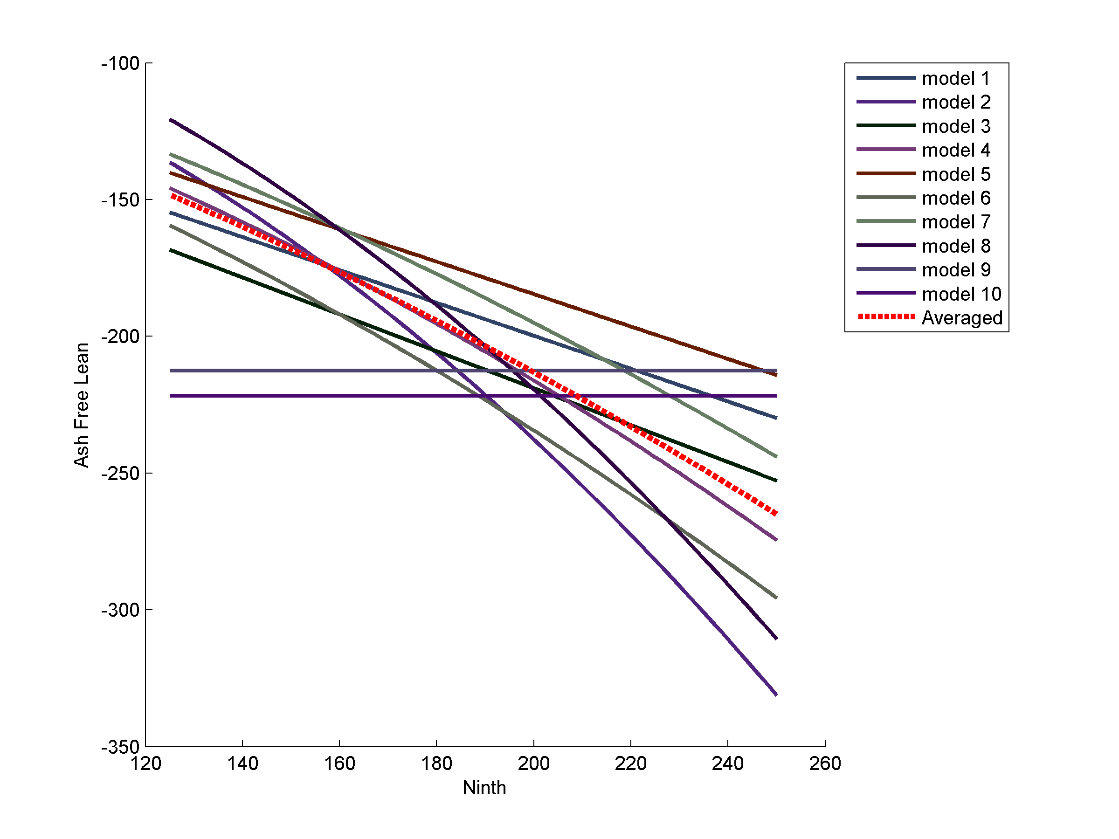
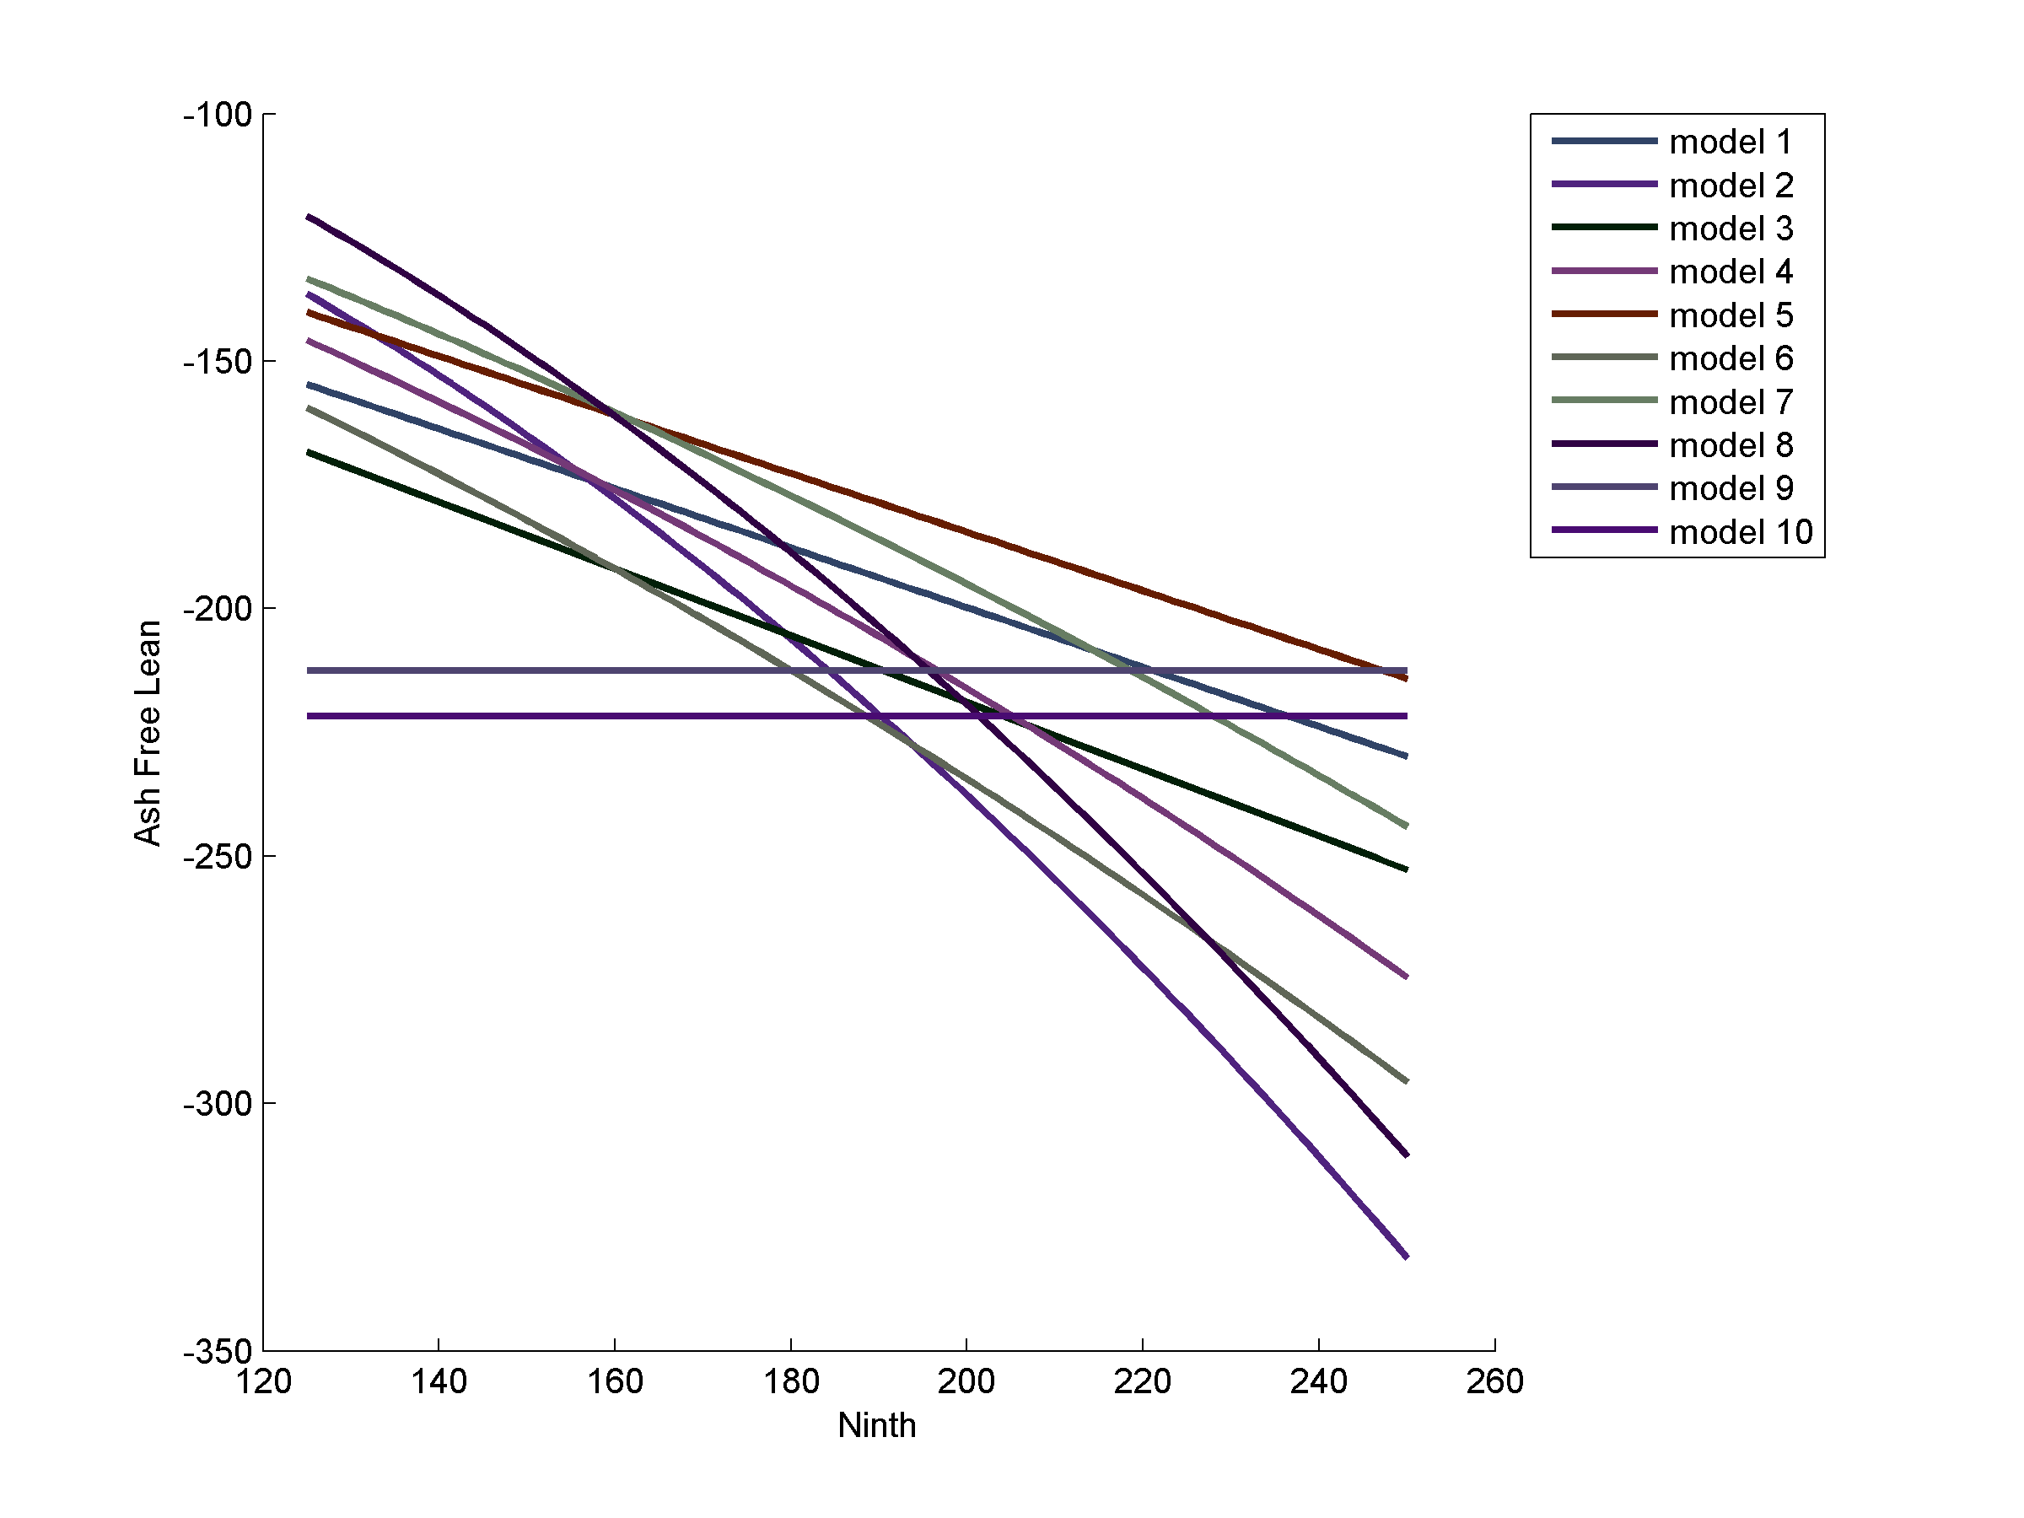
Parameter estimates (graphic)

Slide 65
Unconditional estimates of precision
Estimates of precision based on a single model are conditional on the selected model and tend to overestimate precision.
unconditional variance of a parameter θ (weighted average):

Slide 66
Unconditional estimates of precision (example)

Slide 67
Hypothesis testing
Use AIC, AICc, QAIC, or QAICc in model selection procedures
Likelihood Ratio Tests (LRTs) for planned comparisons among nested models

Slide 68
Hypothesis testing
LRT
  distributed approximately as χ²
  K_{s} - K_{g} degrees of freedom
  (where K = no. estimated parameters
  LRT with P < α – additional parameters are warranted

Slide 69
End of Lecture Material

